Slide 1
Coursera Capstone Multicultural Cities Similarity Detection and Visualization.

Slide 2
Introduction
Predict and visualize similarity between multicultural cities (like New York/Toronto) across the world. If a person from New York migrates to a new city like Toronto and if he wants to start his living in the similar neighborhood where he was living earlier OR if he wants to start a business in similar area, what place can we recommend?
Basically in this problem we will collect data about New York neighborhoods, and pull location data from Foursquare to understand variety of venues. Same exercise would be done for city of Toronto and both the data sets would be combined and clustered using K-means clustering, and similar neighborhoods would be visualized on the world map.

Slide 3
Data
New York and Toronto neighborhood data would be captured from Wikipedia. Also data about longitude and latitude of the data can be extracted from Web. Venue data from Foursquare would be extracted for each neighborhood's 5km radius. Both the data sets would be merged for comparison and clustering. Number of venues for each neighborhood would be aggregated using pandas dataframe which can become base for similarity between the locations.
Exploring these ideas empirically using real world data re-quires that we gather both the description, or the categorizations, of the venues in a city, as well as information about the city’s municipal neighborhood boundaries. For the venues , we collected data from the widely used location-based Social Network (LBSN) Foursquare

Slide 4
Methodology
This problem involves data about various neighborhoods in the city. Various venues and its categories are extracted using Foursquare APIs. Pandas dataframes are used for data understanding and wrangling wherever required. Exploratory data analysis to understand correlation between various fields was not much required as problem we are solving belongs to unsupervised learning category.
Various neighborhoods and its venue categories are merged together in pandas dataframe and mean of number of venues for each neighborhood is captured before applying K-MEANS clustering algorithm.

Slide 5
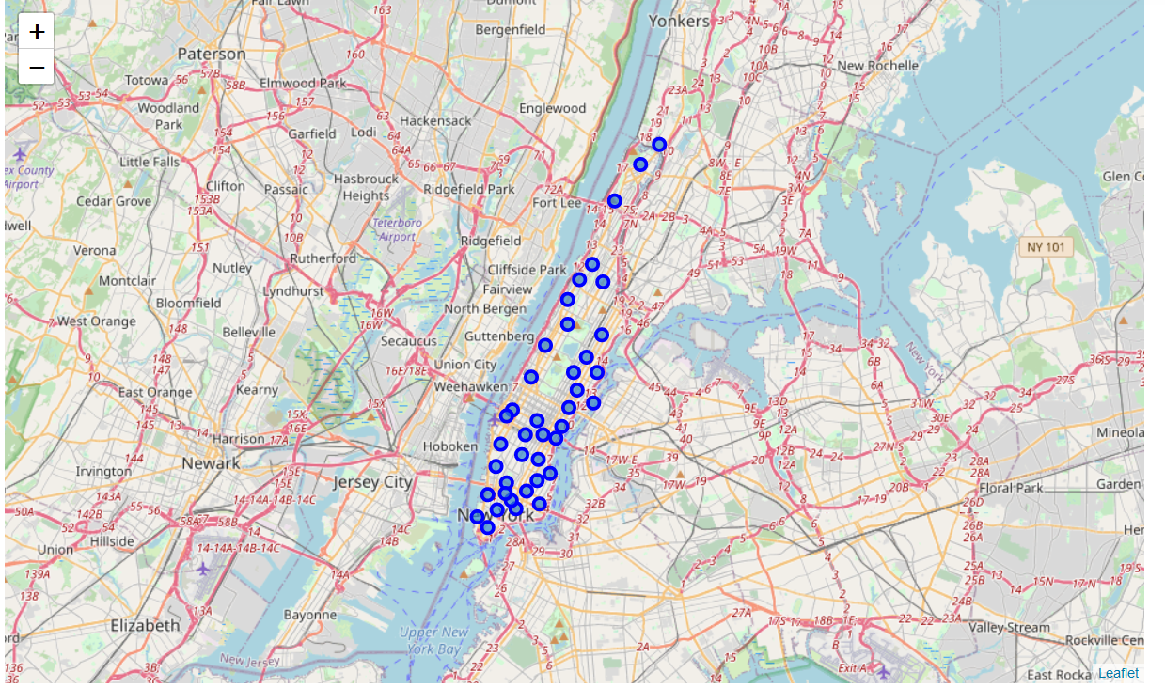
Before clustering

Slide 6
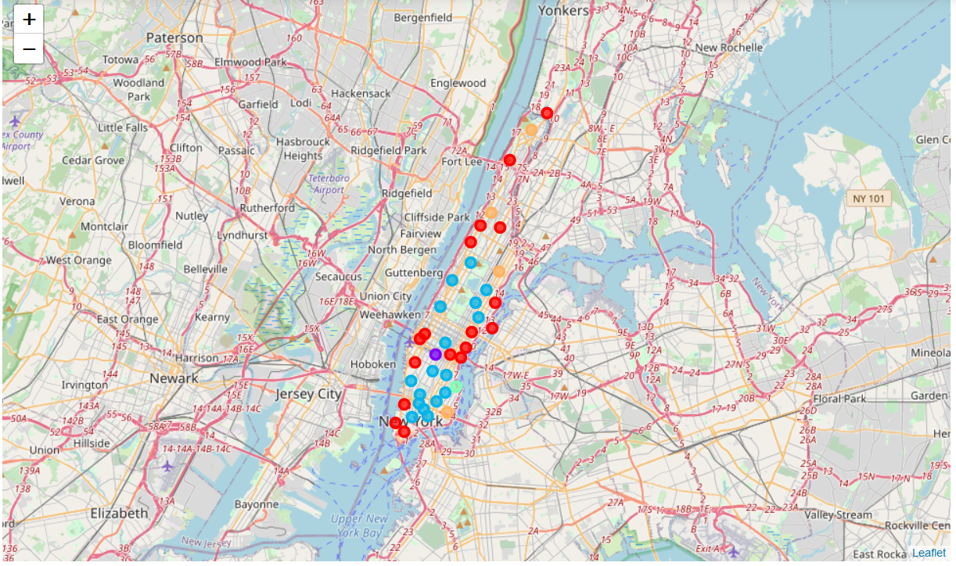
After Clustering..

Slide 7
Conclusion
In this preliminary investigation we have method for comparing cities as vectors of venue categories. We have identified and emphasized the choice of aggregation level and shown that it can have significant quantitative and qualitative effects for city-to-city comparisons. We have presented the results of city similarities as well as an analysis on the frequencies of different venue categories and how each representation may affect them. In future work, we want to carry on a similar analysis between neighborhoods of cities, in order to identify similar neighborhoods across cities and to get a better understanding of cities as collections of individual neighborhoods.

